Slide 1
WHO Guideline on Good Manufacturing Practices for Pharmaceutical Products :
Main Principles (WHO TRS-986; Annex-2)
An Overview of Main Principles and Historical Insights
Md Mohid Islam
Assistant Director, DGDA

Slide 2
History of GMP
References
World Health Organization definition of GMP
Legal Basis and Rationale
Building Blocks of GMP
Essential Elements of GMP
Components of GMP (5P’s)
On-Site inspection and GMP

Slide 3
Tragic incidents of 20th century vs. birth of GMP
In 1901: Death of at least 12 children
Children who received antitoxin for diphtheria treatment died of tetanus because the horse serum that had been used to prepare the antitoxin was contaminated with live tetanus bacilli.
Regulation: Biologics Control Act of 1902 signed into law by President T. Roosevelt. Required inspections of manufacturers and sellers of biological products and testing of such products for purity and strength.
The importance of quality of raw materials was demonstrated, along with the ability of animal-derived materials to pass diseases both known and unknown.

Slide 4
Tragic incidents of 20th century vs. birth of GMP
In 1937: 358 poisonings, 107 deaths (mostly children) and 251 sick but survived in an oral “elixir of sulfanilamide”
Sulfanilamide was a drug in powder form used safely for years to treat streptococcal infections. However as there was a demand for liquid form. Elixir of sulfanilamide was a raspberry flavoured solution in a liquid industrial solvent, dietheylene glycol.
Regulation: Federal Food, Drug and Cosmetic Act of 1938 signed by President F. Rossevelt
For the first time, companies were required to prove that their products were safe before marketing them (FDA overview).

Slide 5
Tragic incidents of 20th century vs. birth of GMP
In 1941: Almost 300 people killed or injured by one company’s sulfathiazole tablets, a sulfa drug tainted with the sedative phenobarbital.
Regulation: that incident caused FDA to drastically revise manufacturing and quality control requirements, leading to what would later be called GMPs.

Slide 6
Tragic incidents of 20th century vs. birth of GMP
In 1955: About 60 inoculated individuals, 10 died and 51 children developed polio.
In 1955, Jonas Salk discovered a way to vaccinate against polio. Many manufacturers began making his polio vaccine. One company failed to inactivate the virus completely in a single lot.
Several possible reasons:
Inconsistent viral inactivation process.
Quick scale-up production without proper validation of inactivation step.
Active live virus production process used heat inactivation step.
For virus scale-up of heat inactivation step may not have been sufficient.

Slide 7
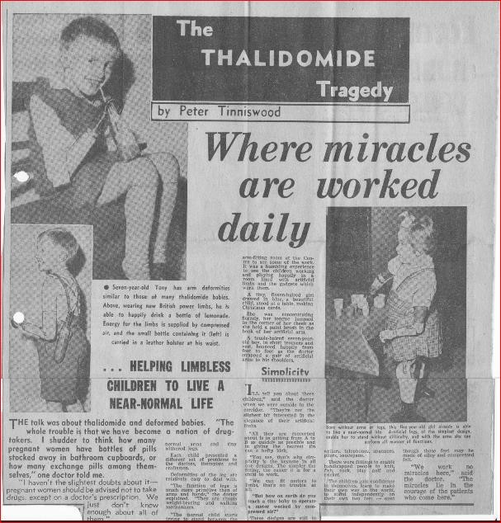
Tragic incidents of 20th century vs. birth of GMP
In 1960’s: Thalidomide was marketed in Europe as a sleeping pill and to treat morning sickness.
It caused serious deformities in developing fetuses. Children whose mothers took thalidomide in the first trimester were born with severely deformed arms and legs. An estimated 10,000 cases of infant deformities in Europe were linked to thalidomide use.
Regulation: companies required to ensure that the products were not only safe, but that they were efficacious for their intended uses. Regulating clinical trials, the amendments required drugs to be tested in animals before people.

Slide 8
WHO-GMP History
The first WHO draft text on good manufacturing practices (GMP) was prepared in 1967 (resolution WHA20.34)
The first version of current Good Manufacturing Practices (GMP) for pharmaceutical products: Main Principles, published as Annex 3 in the WHO Technical Report Series, No. 961, 2011,
The Revised Version published as Annex 2 in the WHO Technical Report Series, No. 986, 2014, which includes the following section-
Section 1 : Pharmaceutical quality system
Section 2 : Good manufacturing practices for pharmaceutical products
Section 7 : Contract production, analysis and other activities
Section 17: Good practices in quality control.

Slide 9
What is Good Manufacturing
Practices?

Slide 10
GMP is that part of QA which ensures that products are consistently produced and controlled to the quality standards appropriate to their intended use and as required by the marketing authorization.
GMP are aimed primarily at diminishing the risks inherent in any pharmaceutical production.
Quality can not be assessed, tested or inspected into the product, BUT it has to be built into it !
Such risks are essentially of two types:
cross-contamination (in particular of unexpected contaminants) and
mix ups (confusion) caused by, for example, false labels being put on containers.
10 |

Slide 11
Why WHO-GMP?
Legal Basis :
ঔষধ ও কসমেটিকস আইন ২০২৩ এর অধ্যায় ০৩ অনুচ্ছেদ নং -১৭
The Drugs Control Ordinance 1982 ; Article 15 (1)

Slide 12
Good Manufacturing Practices:
Essential Elements (17)
1. PQS*
2. Good manufacturing practices for pharmaceutical products
3. Sanitation and hygiene
4. Qualification and validation
5. Complaints
6. Product recalls
7. Contract production and analysis
8. Self-inspection and quality audits
9. Personnel
General
Key personnel
10. Training

Slide 13
Good Manufacturing Practices (17) cont.
11. Personal hygiene 12. Premises 13. Equipment | 14. Materials General Starting materials Packaging materials Intermediate and bulk products Finished products Rejected, recovered, reprocessed and reworked materials Recalled products Returned goods Reagents and culture media Reference standards Waste materials Miscellaneous

Slide 14
Good Manufacturing Practices (17) cont.
15. Documentation
General
Documents required:
Labels
Testing procedures
Specifications for starting and packaging materials, for intermediate and bulk products and for finished products
Master formulae and Batch Processing Records
Packaging instructions and Batch Packaging Records
Standard Operating procedures (SOP's) and records
Logbooks

Slide 15
Good Manufacturing Practices (17) cont.
16. Good practices in production
General
Prevention of cross-contamination and bacterial contamination during production
Processing operations
Packaging operations
17. Good practices in quality control
Control of starting materials and intermediate, bulk and finished products
Test requirements
Batch record review
Stability studies

Slide 16
Building Blocks of GMP

Slide 17
Quality management in the medicines industry
Usually defined as the aspect of the management function that determines and implements the “quality policy”.
The quality policy is a statement by the top management of the company of its overall intentions and direction relating to quality, formally expressed as a corporate policy.

Slide 18
Quality Management (cont.)
The basic elements of quality management are:
an appropriate infrastructure or “quality system”, encompassing the organizational structure, procedures, processes and resources;
systematic actions necessary to ensure adequate confidence that a product (or service) will satisfy given requirements for quality.
The totality of these actions is termed “QA”. Within an organization, QA serves as a management tool.
The concepts of QA, GMP, QC and quality risk management (QRM) are interrelated aspects of quality management and should be the responsibility of all personnel.

Slide 19
Pharmaceutical Quality System (PQS*)
Principle:
The manufacturer must assume responsibility for the quality of the pharmaceutical products to ensure that they are fit for their intended use, comply with the requirements of the marketing authorization and do not place patients at risk due to inadequate safety, quality or efficacy. (1.1)
The attainment of the quality objective is the responsibility of senior management and requires the participation and commitment of everyone.
To achieve this quality objective reliably there must be a comprehensively designed and correctly implemented pharmaceutical quality system (PQS) incorporating GMP and QRM

Slide 20
PQS (cont.)
Senior management has the ultimate responsibility to ensure an effective PQS is in place, is adequately resourced, and that roles, responsibilities, and authorities are defined, communicated and implemented throughout the organization.
Senior management’s leadership and active participation in the PQS is essential.
Quality management, therefore, incorporates GMP and other factors, including those outside the scope of this guide, such as product design and development.
(1.3)

Slide 21
Scope : PQS vs GMP
The PQS can extend to the pharmaceutical development life-cycle stage and should facilitate innovation and continual improvement and strengthen the link between pharmaceutical development and manufacturing activities.
GMP applies to the life-cycle stages from the manufacture of investigational medicinal products, technology transfer, and commercial manufacturing, through to product discontinuation. (1.4)

Slide 22
PQS and QRM
WHO expectations to achieve Consistency:
Manufacture in accordance with the requirements of a PQS based on a life-cycle approach defined in WHO main GMP principles.
Special focus on:
Link between development and manufacturing
Validation
Change control
CAPA
Continual improvement, innovation.
QRM should ensure that: the evaluation of the risk to quality is based on scientific knowledge, experience with the process and ultimately links to the protection of the patient. (1.9)

Slide 23
PQS (cont.)
There should be periodic management reviews, with the involvement of senior management, of the operation of the PQS to identify opportunities for continual improvement of products, processes and the system itself. Unless otherwise justified, such reviews should be conducted at least annually. 1.6
The PQS should be defined and documented. A quality manual or equivalent documentation should be established and should contain a description of the quality management system including management responsibilities. 1.7

Slide 24
Relationships of Quality
Quality Assurance
Quality Management
Quality Control
GMP
Sampling Specifications Testing
Personnel Training Validation
Self inspection
Quality Objective Quality Manual
Quality system Quality Policy

Slide 26
GMP for pharmaceutical products
All manufacturing processes are clearly defined, systematically reviewed* for associated risks in the light of scientific knowledge and experience, and shown to be capable of consistently manufacturing.
All necessary resources are provided, including:
(i) sufficient and appropriately qualified and trained personnel,
(ii) adequate premises and space,
(iii) suitable equipment and services,
(iv) appropriate materials, containers and labels,
(v) approved procedures and instructions,
(vi) suitable storage and transport,
(vii) adequate personnel, laboratories and equipment. 2.1,1.10 *PQR

Slide 27
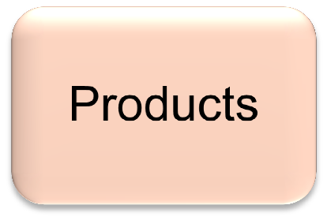
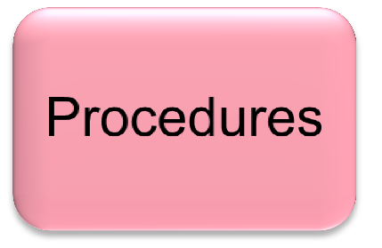
Components of GMP (5P’s)

Slide 28
sanitation and hygiene
The scope of sanitation and hygiene covers:
personnel, premises, equipment and apparatus, production materials and containers, products for cleaning and disinfection, and anything that could become a source of contamination to the product.
3.1

Slide 29
Personal hygiene
All personnel, prior to and during employment, as appropriate, should undergo health examinations. Personnel conducting visual inspections should also undergo periodic eye examinations. 11.1
All personnel should be trained in the practices of personal hygiene. A high level of personal hygiene should be observed by all those concerned with manufacturing processes. In particular, personnel should be instructed to wash their hands before entering production areas. Signs to this effect should be posted and instructions complied with. 11.2

Slide 30
Qualification and Validation
The key elements of a qualification and validation programme of a company should be clearly defined and documented in a validation master plan. 4.2

Slide 31
Complaints
Principle: All complaints and other information concerning potentially defective products should be carefully reviewed according to written procedures and the corrective action should be taken.
A person responsible for handling the complaints and deciding the measures to be taken should be designated.
There should be written procedures describing the action to be taken, including the need to consider a recall, in the case of a complaint concerning a possible product defect. 5.1-5.3

Slide 32
Product recalls
Principle: There should be a system to recall from the market, promptly and effectively, products known or suspected to be defective. 6.1
The authorized person should be responsible for the execution and coordination of recalls. He or she should have sufficient staff to handle all aspects of the recalls with the appropriate degree of urgency. 6.2
There should be established written procedures, which are regularly reviewed and updated, for the organization of any recall activity. Recall operations should be capable of being initiated promptly down to the required level in the distribution chain. 6.3

Slide 33
Personnel
Principle: The establishment and maintenance of a satisfactory system of QA and the correct manufacture and control of pharmaceutical products and active ingredients rely upon people. For this reason there must be sufficient qualified personnel to carry out all the tasks for which the manufacturer is responsible. Individual responsibilities should be clearly defined 9.1
Steps should be taken to prevent unauthorized people from entering production, storage and QC areas. Personnel who do not work in these areas should not use them as a passageway. 9.5

Slide 34
Personnel (cont.)
Key personnel: include the heads of production, the head(s) of quality unit(s) and the authorized person. The quality unit(s) typically comprise the quality assurance and quality control functions. 9.7-9.14
Key personnel responsible for supervising the production and quality unit(s) for pharmaceutical products
Authorized person: The person recognized by the national regulatory authority as having the responsibility for ensuring that each batch of finished product has been manufactured, tested and approved for release in compliance with the laws and regulations in force in that country.

Slide 35
Training
The manufacturer should provide training in accordance with a written programme for all personnel whose duties take them into manufacturing areas or into control laboratories (including the technical, maintenance and cleaning personnel) and for other personnel as required.
Besides basic training on the theory and practice of GMP, newly recruited personnel should receive training appropriate to the duties assigned to them. Continuing training should also be given, and its practical effectiveness periodically assessed. Approved training programmes should be available. Training records should be kept.
Consultant and contract staff should be qualified for the services they provide. Evidence of this should be included in the training records. 10.1-10.2

Slide 36
Summary and conclusions:
GMP compliance is not an option
Quality should be built into the product
GMP's are very similar and are really Good Common Sense and should be blended with Risk based thinking*
The role and involvement of senior management is crucial*
*PQS

Slide 37
Thank You

